Slide 1
BANKING MANAGEMENT SYSTEM
BY
SAIPRIYA GAJJELA

Slide 2
ABSTRACT
The program accepts the number of customers we need to add and adds the customer and account details accordingly. Further, it displays the series of menus to operate over the accounts.
The series of menus displayed are as follows:
Display all account details
search by account number
Deposit the amount
Withdraw the amount
Exit

Slide 3
Application Description:
The Bank Management System is an application for maintaining a person’s account in a bank.
The System provides the access to the customer to create an account, search account, Deposit/Withdraw the cash from an account.
Th following presentation provides the specification from the System.

Slide 4

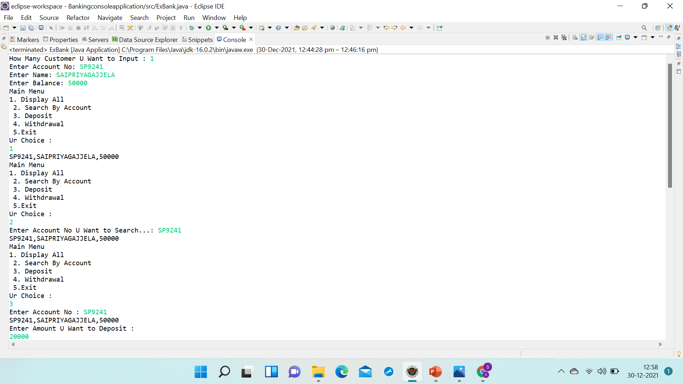

Slide 5


